Slide 1

SOFTWARE
DEVELOPMENT
AND
ANALYSIS
TECHNOLOGY
ADSO
2805921
CARMEN L.
ÁLVAREZ MATOZA

Slide 2
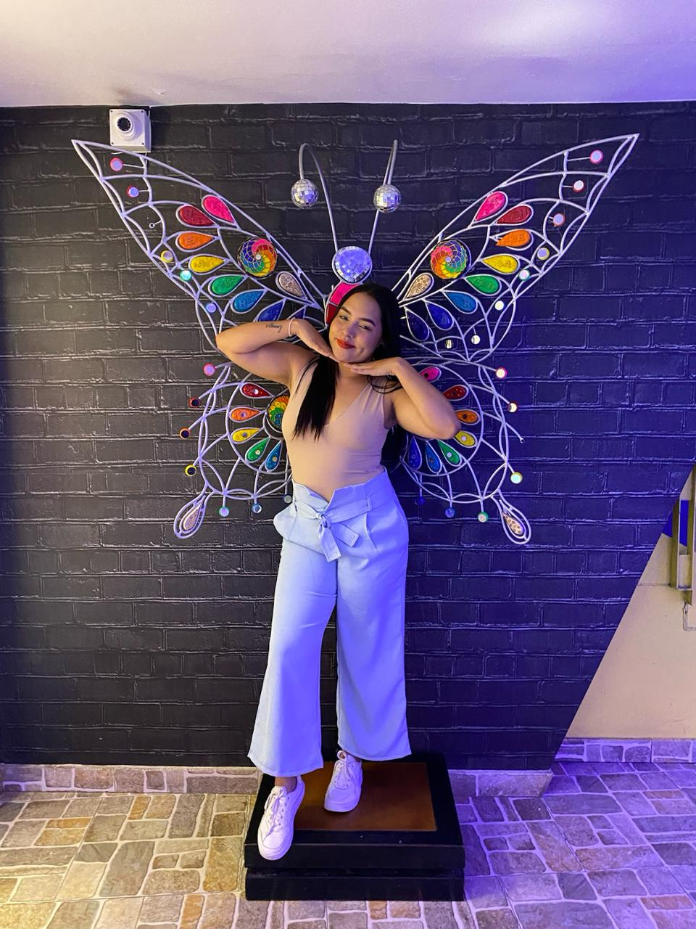
MY FAVORITE PERSON

Slide 3
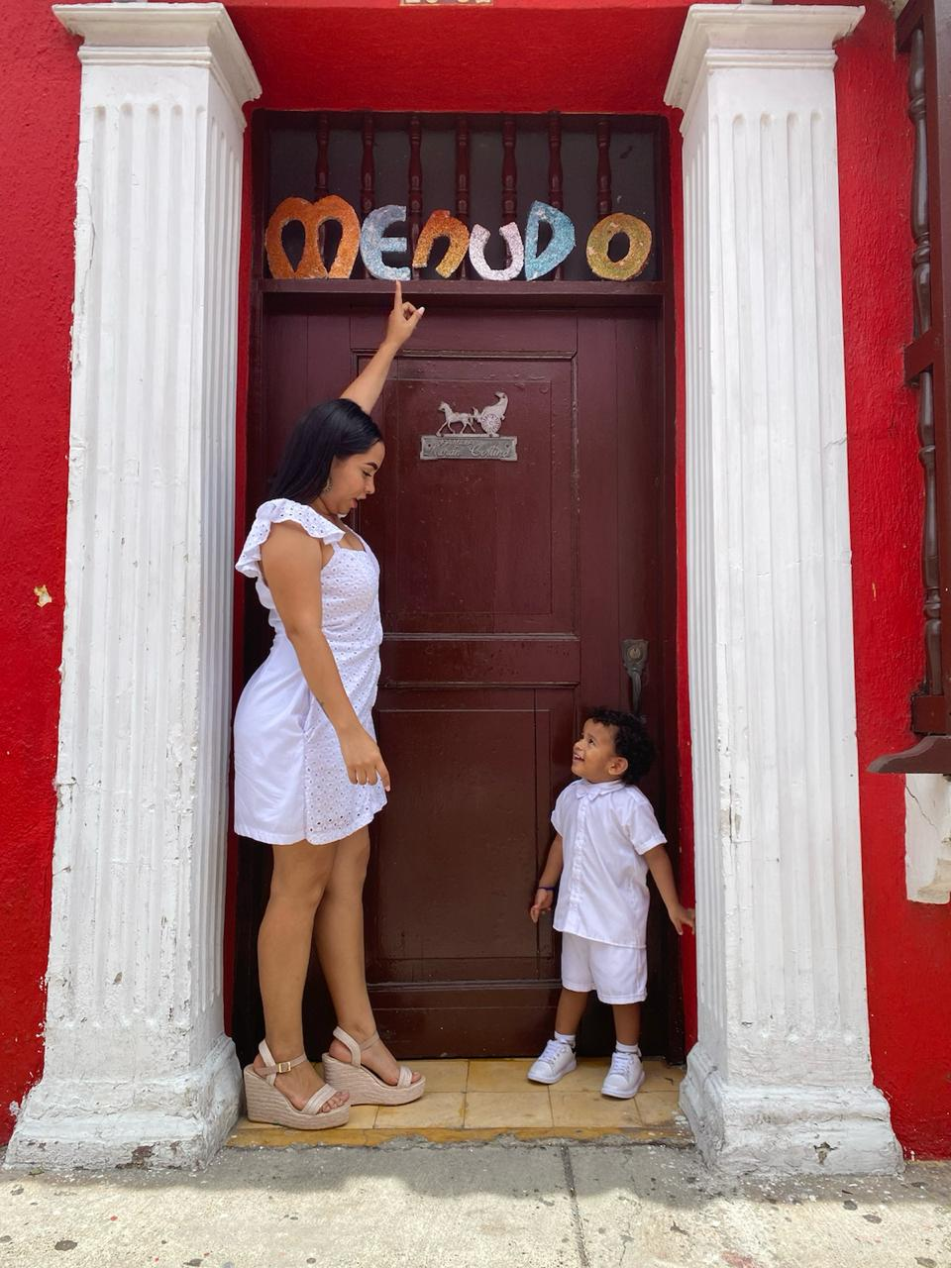
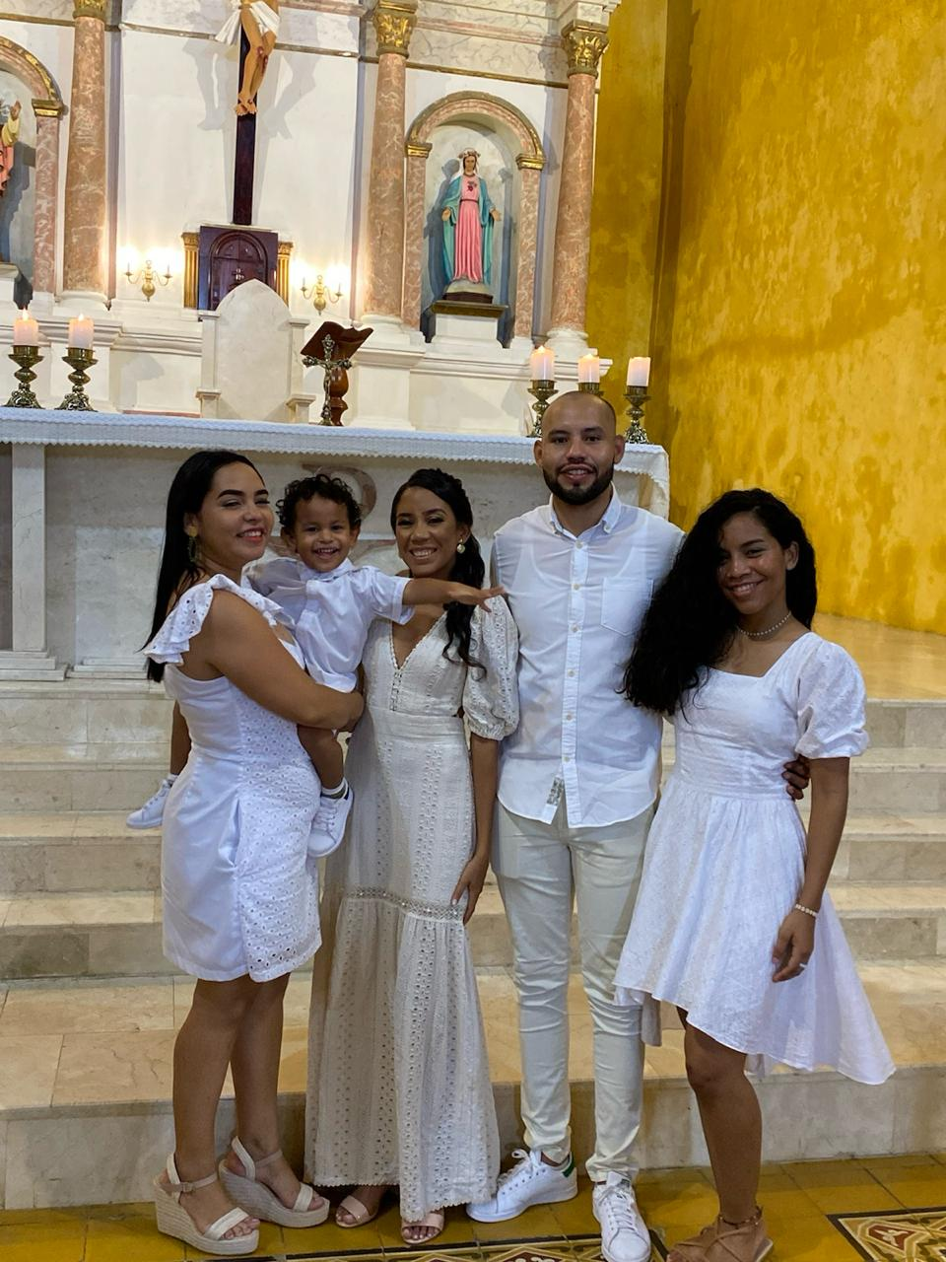
MOM'S FACET

Slide 4
THANKS!

